Slide 1
New calorimetric technology for eRHIC.
O.Tsai (UCLA) BNL, March 9, 2010
Updated, June 1, 2010

Slide 2
The proposal for R&D for new calorimetric technology can be found at http://www.physics.ucla.edu/~tsai/bemc/RDproposal _v5.pdf
This proposal was written with assumption that it will be a dedicated eRHIC detector. The topic of today discussion is (not) STAR, thus I decided to put couple of slides which will serve as an introduction (if you wish, it is my, probably, biased view how sampling calorimetric technology was developing in the recent past and where it is now).
I will discuss only sampling calorimeters.

Slide 3
Simple classification of different sampling calorimeters.
I will classify sampling calorimeters in three different groups using this equation. First group has small d and Fs, second has small d but large Fs, and third has large d and Fs. Of course, boundaries is not well defined and there is migration between groups, but in general I think it will work for this discussion.
Next slide shows that (3) describes energy resolution of sampling calorimeters reasonably well.

Slide 4
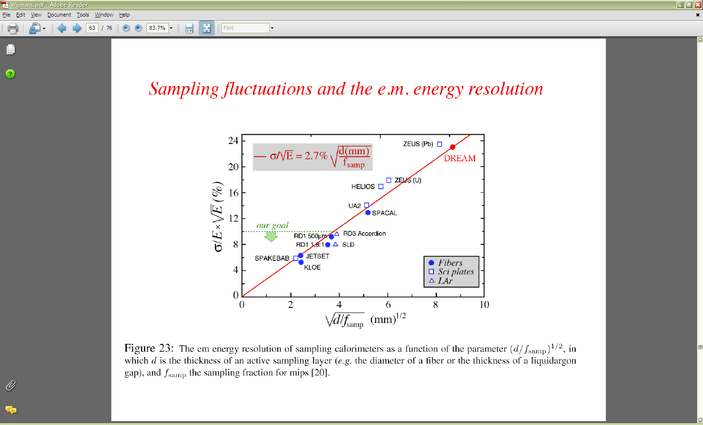
R.Wigmans , Calor 2010

Slide 5
Simple classification table.
Small d, Small Fs (A) This is ScFi calorimeters. Key words: Good energy , position resolution. Fast, compact, hermetic. Problems are; Projectivity, high cost (1/10th of crystals). Example (H1) Rm 1.8 cm X0 0.7 cm Energy reso. ~ 10% (1 GeV) Density ~ 10 g/cm^3 Number of fiber/tower~ 600 (0.3 mm diameter, 0.8mm spacing) | Small d, Large Fs (B) This is “Shashlik” type. Key words: Excellent energy resolution Reasonably fast Small dead areas Problems are: Low density, projectivity. Moderate cost Example (KOPIO/PANDA) 6 cm 3.4 cm 4% 2.5 g.cm^3 0.3 mm Pb/1.5 mm Sc 400 layers | Large d, Large Fs (C) Tile/Fiber type. Key words: Ok energy resolution Reasonably fast Very cost effective Problems are: Moderate density, large dead areas. Example (STAR BEMC) 3 cm 1.2 cm 15% 6 g/cm^3 5mm Pb/ 5mm Sc 20 layers
We proposing to develop new technology for (A) but keep the price tag from (C).

Slide 6
Some trends, a bit of history and what we can take from HEP past and ongoing R&Ds…
As it was shown in slide 4, ScFi calorimeters were among the best before the LHC. For LHC all three types were considered. By the end (b) and (c) is in use or will be in use. Developments in (a) type was halted till about 2003. I don’t have good explanation why type (a) is not in use…
The clear winner is Crystal Clear Collaboration (CERN 1990), we now have PWO, and “thin” Hamamatsu APDs. Both in use in large scale experiments,
but …(see Wigman’s talk at Calor 2010).
Type (b) were mature before LHC. ALICE, LHCb, PANDA is (will) be using this type. How type (b) will fit into (m)eRHIC is not clear.
All digital for PFA??? Some things developed for these may be interesting to play with MPPC (not cheap, Hamammatsu 6mm x 6mm ~60k pixels - $600)

Slide 7
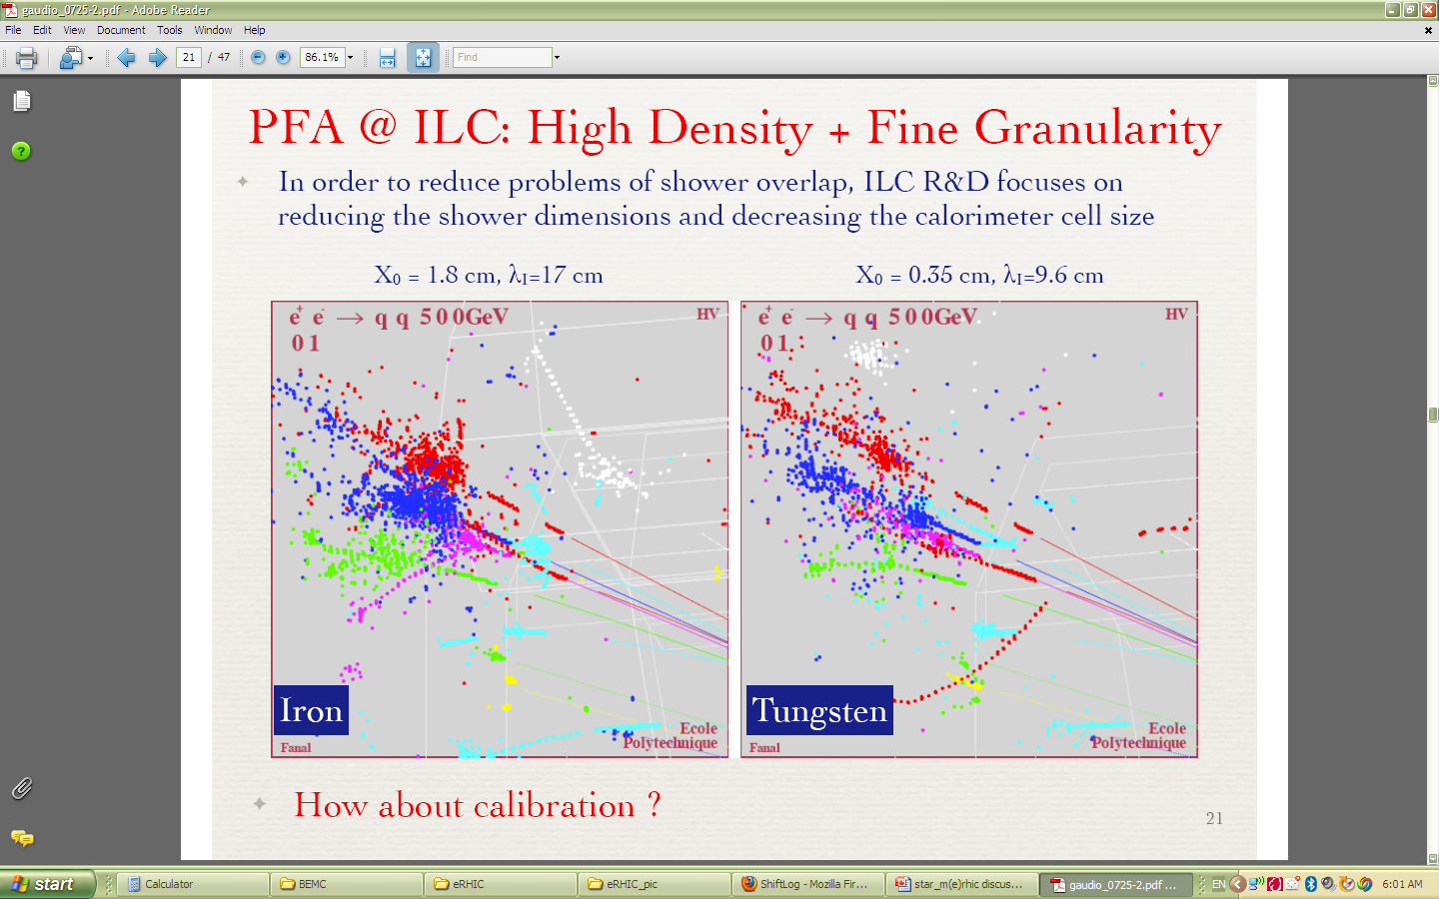
Continuing from slide 6
ILC R&D. Design driven by jet resolution at 30%/sqrt(E). New era of digital calorimeters?

Slide 8
PFA
PFA (Particle Flow Analysis) is thought to be a way to get best jet-energy resolution
Measure energy of each particle separately
  Charged particle : by tracker
  Gamma : by EM Calorimeter
  Neutral hadron : by EM and Hadron Calorimeter
Overlap of charged cluster and neutral cluster in the calorimeter affects the jet-energy resolution
Cluster separation in the calorimeter is important
  Large Radius (R)
  Strong B-field
  Fine 3-D granularity (σ)
  Small Moliere length (R_{M})
  Algorithm
Often quoted figure of merit :

Slide 9
Continuing from slide 6
Should we follow the trends?
Very rapid development of MPPC (Invented in Russia around 2003, patented ?, mass production by Hamamatsu for T2K started in 2008).
For ILC they still wanted MPPC with large dynamic range. For tile type calorimeters for RHIC existing devices probably good enough already.
If we’ll follow the trend then MPPC is the technology that we should consider. Probably, type (c) ecals will be cheaper to build utilizing MPPC.
For example, if STAR will be thinking to add second endcap MPPC will look attractive.

Slide 10
Sub-detector R&D: CAL
Photon sensor R&D – MPPC
  Merit of MPPC
    Work in Magnetic Field
    Very compact and can be directly mounted on the fiber
    High gain (~10⁶) with a low bias voltage (25~80V)
    Photon counting capability at room temperature

Slide 11
Sub-detector R&D: CAL
Configuration
  EM CAL: Tungsten-Scintillator strip sandwich
  Hadron CAL: Lead-Scintillator strip/tile sandwich
  Wavelength shifting fiber and MPPC readout for both CALs
MPPC: Multi Pixel Photon Counter

Slide 12
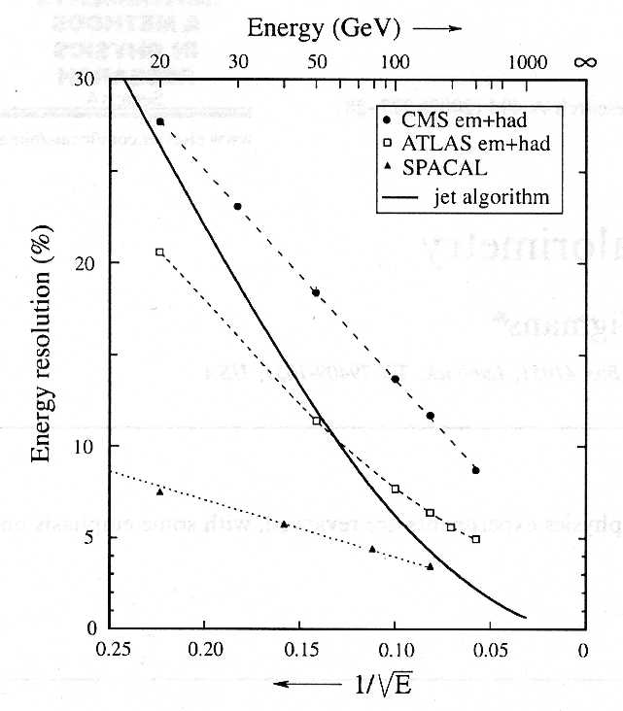
But, let’s come back to type (A) calorimeters… Should we follow the trends?

Slide 13
Or, SPACAL type is what will do the job?
Reasonably good em energy resolution.
Excellent hadron resolution (still hold the record, DREAM is not there yet).
Flexible granularity.
Fast.
Hermetic.
Internal e/h rejection.

Slide 14
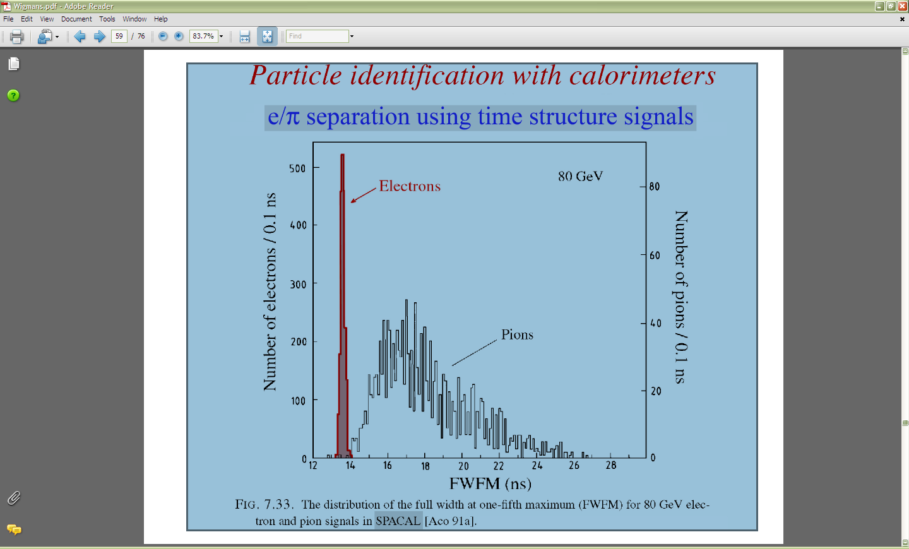

Slide 15
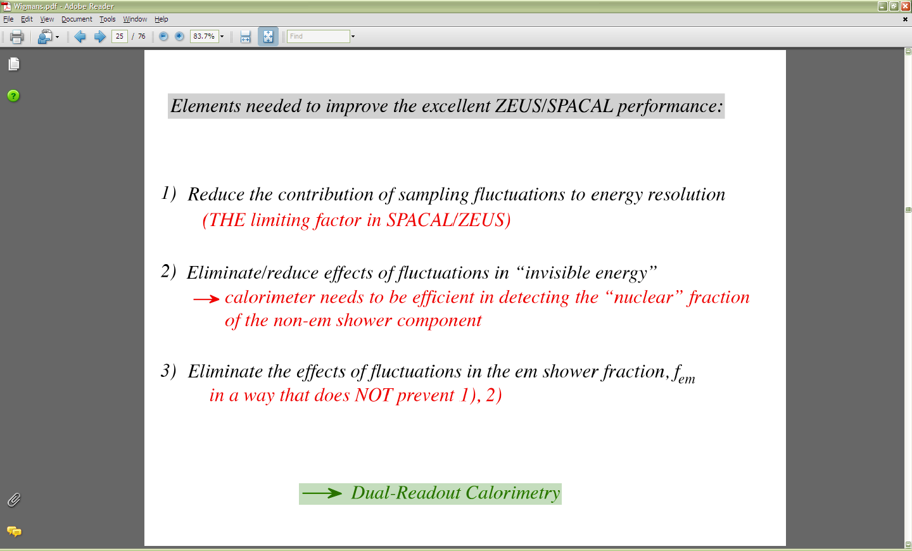
R.Wigmans, Calor 2010
We are proposing technology which will reduce this “THE limiting factor”

Slide 16
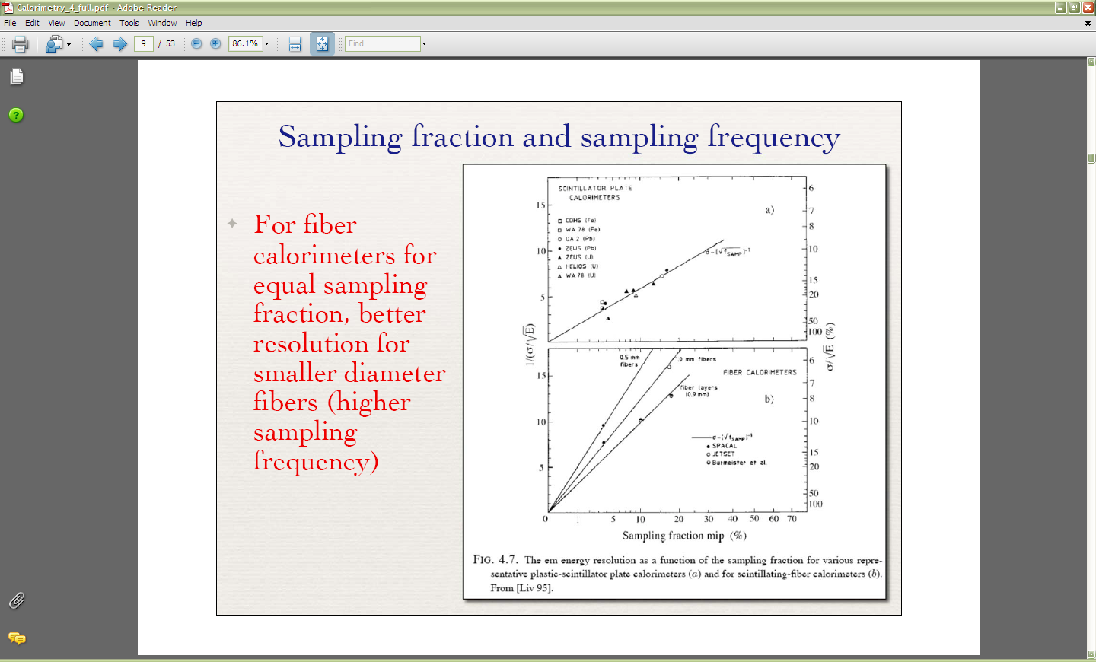
M.Livan “The Art of calorimetry Lecture IV”

Slide 17
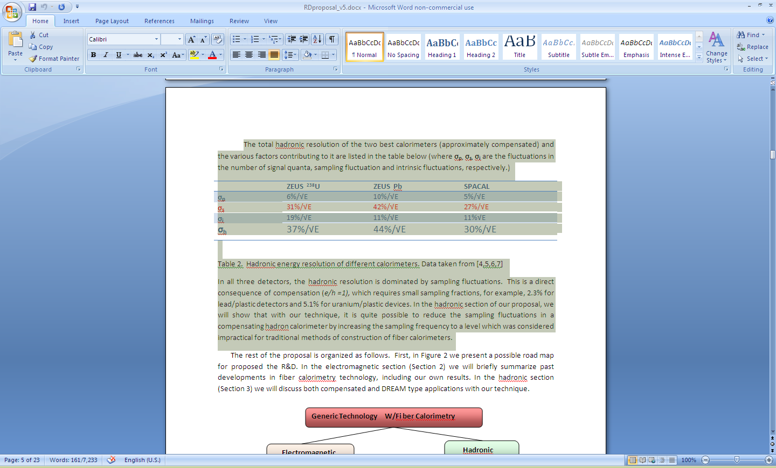

Slide 18
For the reset of the talk I will using pages from the proposal. Please open it at http://www.physics.ucla.edu/~tsai/bemc/RDproposal _v5.pdf

